Slide 1

BAN 502 Course Project Phase 1: Descriptive and Exploratory Data Analysis
Jonathan West

Slide 2
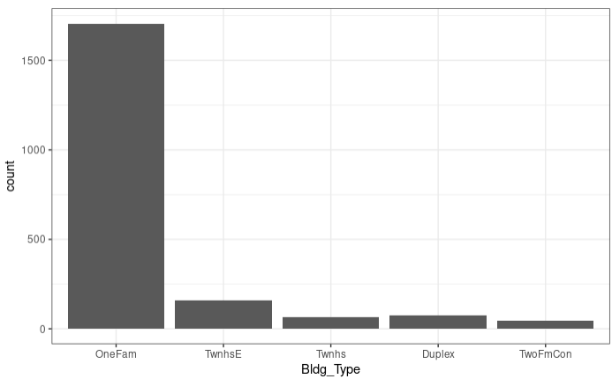
Quick Overview of Ames, Iowa Housing Data
There are 81 different variables and 2,053 observations in this dataset.
Bldg_Types Sold:
One Fam = 1706
TwnhsE = 157
Twnhs = 67
Duplex = 76
TwoFmCon = 47

Slide 3
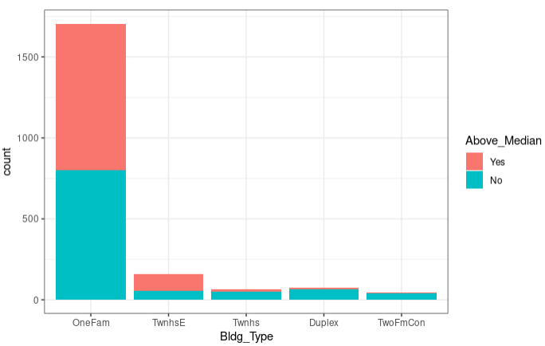
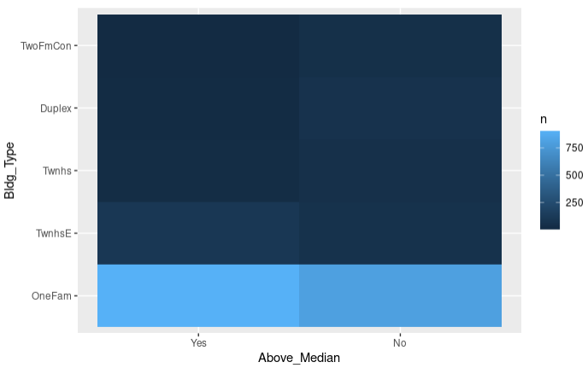
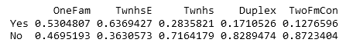
What does the distribution of Building Types that were sold above/below Median Price look like?

Slide 4
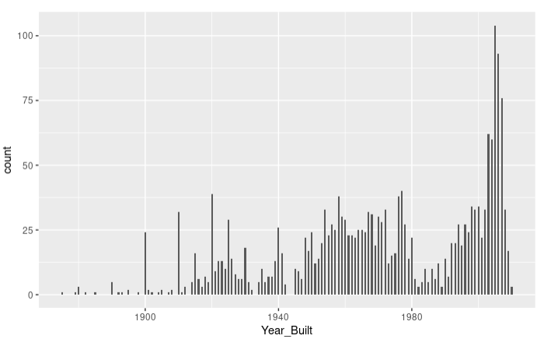
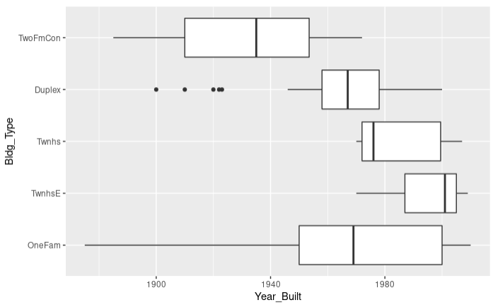
Visualizing Distribution Histogram & Boxplot for the Year each House was built.

Slide 5
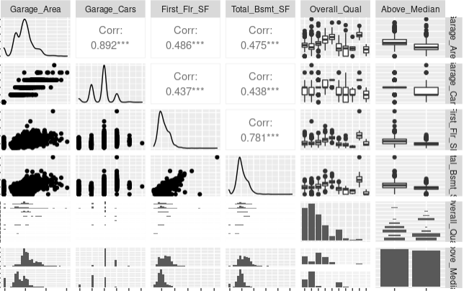
Strong Predictors of Above_Median - Notice by carefully looking at the plots in the last rows, we can see that the increase may not be linear.

Slide 6
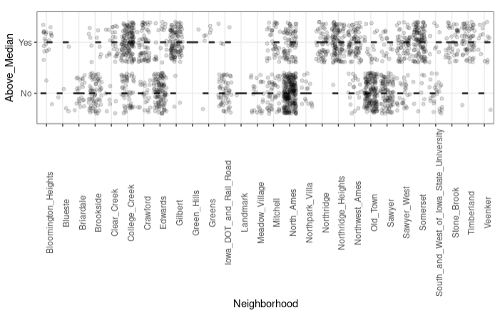
It’s clear that some neighborhoods have a positive correlation with Above_Median

Slide 7
Thank you
Jonathan West

